Slide 1
Topic: Factorising Trinomials – Revision EQ: Do I remember what a monic trinomial is?

Slide 2
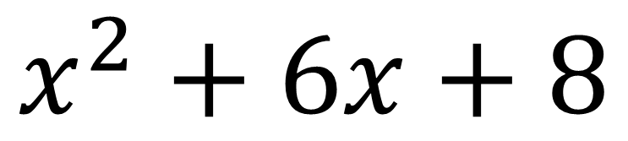
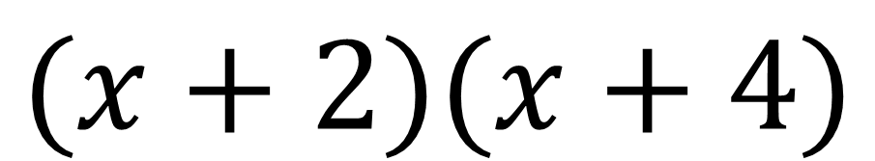
Expanding vs Factorising.
Expanding
Factorised
Form
Expanded
Form
$$(x+2)(x+4)$$
$$x^{2}+6x+8$$
Factorising

Slide 3
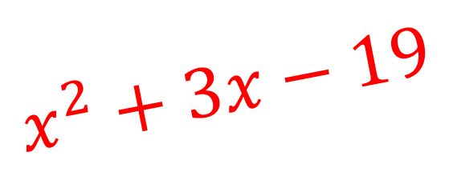
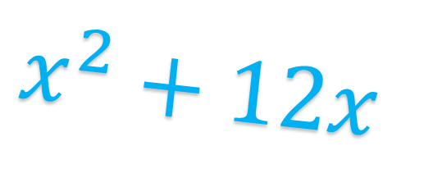

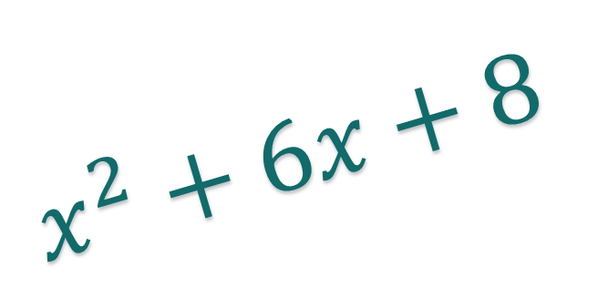


Monic Trinomials
Monic trinomials are polynomials (expressions with multiple powers of x) with 3 terms. This means they have 3 terms, each with a different power of x (${ax}^{2}+bx+c)$ and it means that the coefficient of the $x^{2}$ term is 1.
$$x^{2}−16$$
$$x^{2}+3x−19$$
$$x^{2}+12x$$
$$x^{2}+6x+8$$
$$x^{2}+6x+8$$

Slide 4
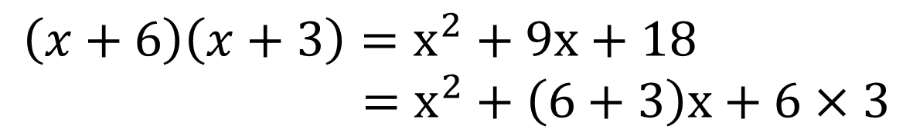

Factorising Monic Trinomials
Topic: Factorising Trinomials – Revision
EQ: Do I remember what a monic trinomial is?
Consider the expression $\left(x+m\right)\left(x+n\right)$
This expands to give: $x^{2}+\left(m+n\right)x+mn$
If we want to factorise something in the form $x^{2}+bx+c$ we can see from the above that b must be equal to m + n and c must be equal to m x n
$$\left(x+6\right)\left(x+3\right)=x^{2}+9x+18 \\ =x^{2}+\left(6+3\right)x+6×3$$

Slide 5
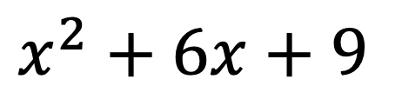

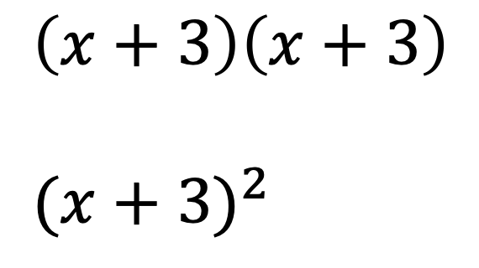
Quadratic Trinomials
A quadratic trinomial is a quadratic expression with all three terms in the form of $ax^{2}+bx+c$ where; x is a variable, a, b, and c are numbers and not zero.
…The constant a is called the leading coefficient, b is called the linear coefficient, and c is called the additive constant (or just constant).
…Also, a quadratic trinomial is the product of two linear factors; and the factors of a quadratic trinomial are linear factors.
And lastly, a quadratic expression is defined as an expression in which the second degree is the highest power, and the expression has one variable
$$x^{2}+6x+9$$
$$\left(x+3\right)\left(x+3\right)$$
$${(x+3)}^{2}$$

Slide 6


How to factorise?
Topic: Factorising Trinomials – Revision
EQ: Do I remember what a monic trinomial is?
We need to look for factors of c (i.e. m x n) that add to b (m + n)
$$Factorise:x^{2}+7x+10$$
Think:
Is there a Highest Common Factor?
What are the factors of c?
Which pair of factors add to b?
Are my signs correct?
Rewrite bx with your factors as coefficients
Do:
No HCF
10 = 1 x 10, 2 x 5
2 x 5
Both C and B are positive, so yes.
$x^{2}+2x+5x+10$

Slide 7


How to factorise?
We need to look for factors of c (i.e. m x n) that add to b (m + n)
$$Factorise:x^{2}+7x+10$$
Think:
Is there a Highest Common Factor?
What are the factors of c?
Which pair of factors add to b?
Are my signs correct?
Rewrite bx with your factors as coefficients
Factor each pair of terms
Factor by grouping.
Expand to check.
Do:
No HCF
10 = 1 x 10, 2 x 5
2 x 5
Both C and B are positive, so yes.
$x^{2}+2x+5x+10$
$x\left(x+2\right)+5\left(x+2\right)$
$(x+5)(x+2)$
$x^{2}+5x+2x+10=x^{2}+7x+10 √$

Slide 8

Demonstration
$x^{2}+8x+16$
$x^{2}−18x+81$

Slide 9
Demonstration
$x^{2}+8x+16$
$x^{2}−18x+81$

Slide 10
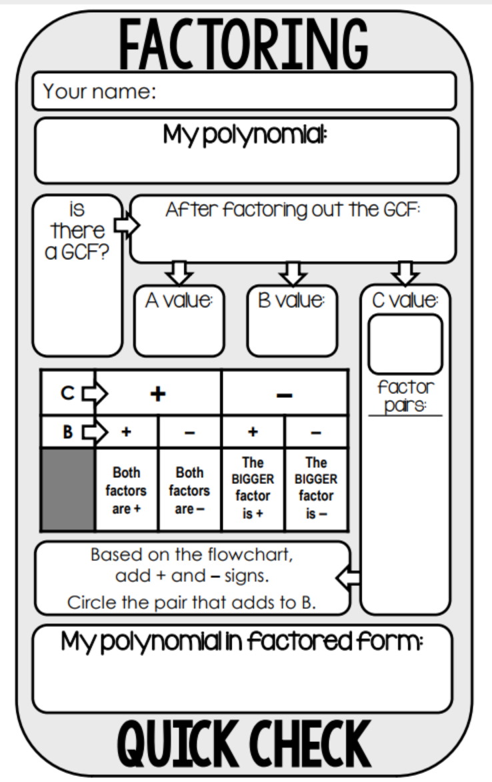











Quick Check Template:
$$x^{2}+10x+16$$
$$x^{2}+10x+16$$
This is a really useful template to assist you in factorising trinomials.
$$NO$$
$$1$$
$$10$$
$$16$$
Example:
Factorise $x^{2}+10x+16$
$$1,16$$
$$2,8$$
$$4,4$$
$$(x+2)(x+8)$$

Slide 11









Quick Check Template:
$$x^{2}−x−20$$
$$x^{2}−x−20$$
This is a really useful template to assist you in factorising trinomials.
$$NO$$
$$1$$
$$−1$$
$$−20$$
Example:
Factorise $x^{2}−x−20$
$$1,20$$
$$2,10$$
$$4,5$$
$$(x+4)(x−5)$$

Slide 12











Quick Check Template:
$${2x}^{2}+12x−80$$
$${2(x}^{2}+6x−40)$$
This is a really useful template to assist you in factorising trinomials.
$$2$$
$$1$$
$$6$$
$$−40$$
Example:
Factorise ${2x}^{2}+12x−80$
$$1,40$$
$$2,20$$
$$4,10$$
$$5,8$$
$$2(x−4)(x+10)$$

Slide 13
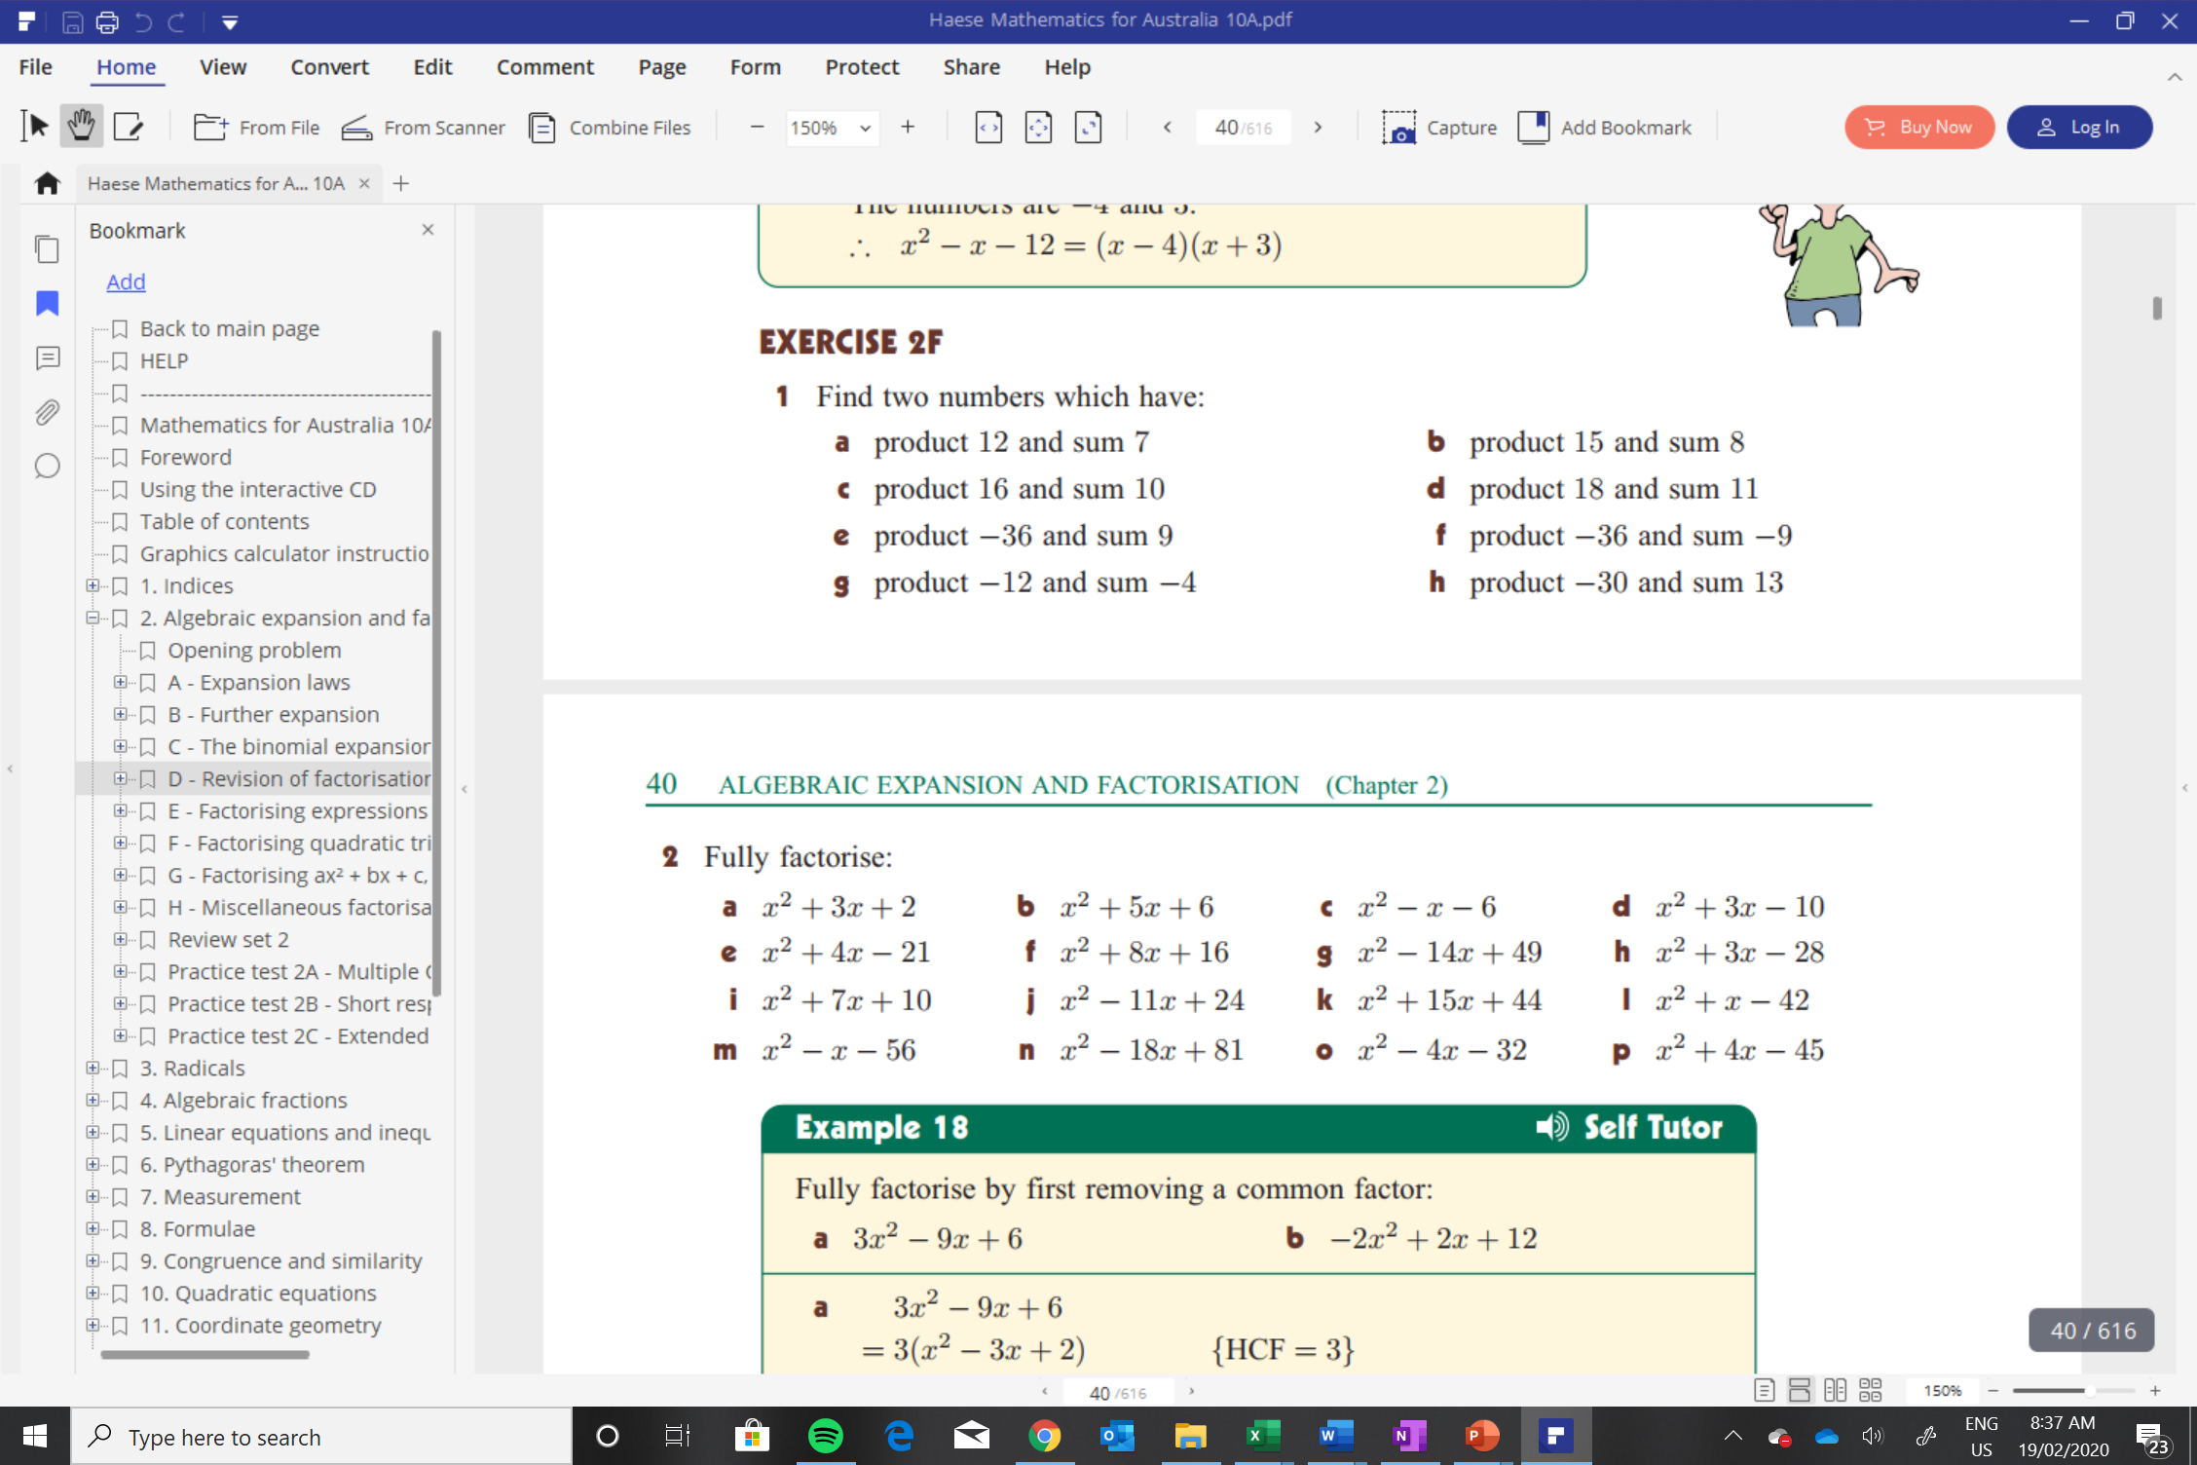

Slide 14
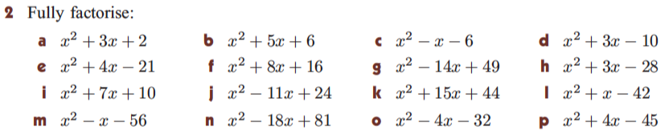
Independent Practise

Slide 15
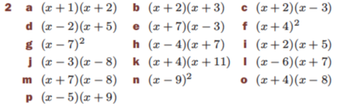
Solutions

Slide 16
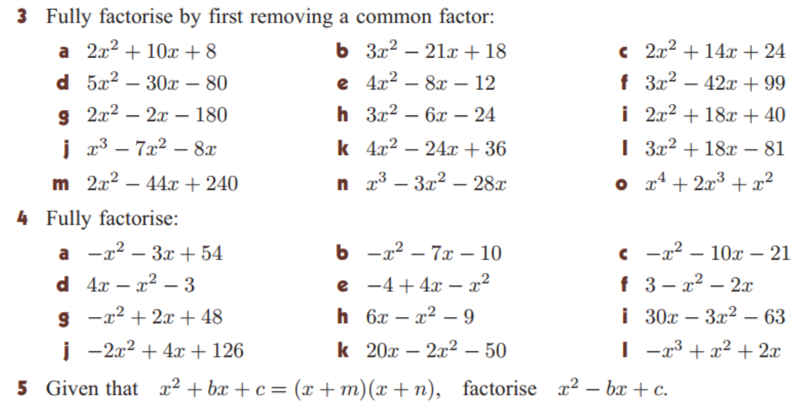

Slide 17
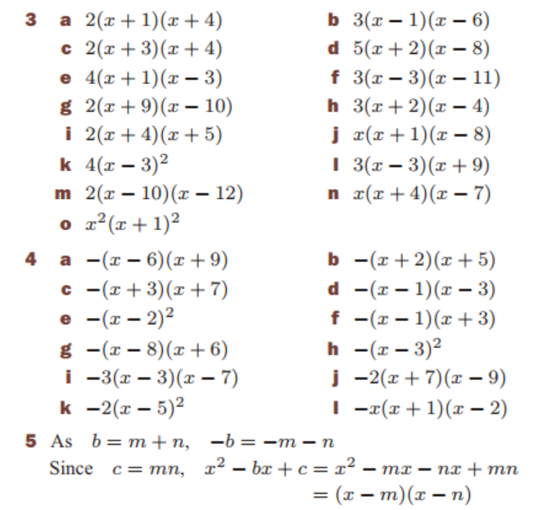
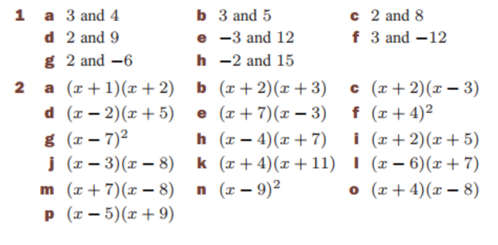
Solutions:

Slide 18
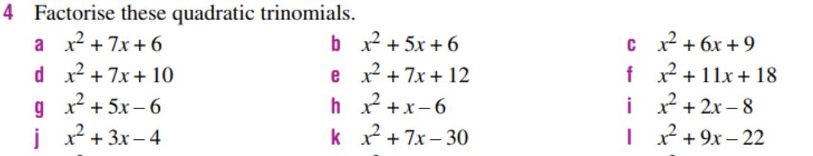
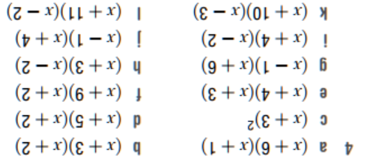
Homework:

